Slide 1
Java Collections Framework

Slide 2
Introduction
A data structure is a collection of data organized in some fashion.
In object-oriented thinking, a data structure, also known as a container , is an object that stores other objects, referred to as data or elements.

Slide 3
Introduction
The Java Collections Framework supports two types of containers:
One for storing a collection of elements, simply called a collection .
The other for storing key/value pairs, called a map.

Slide 4
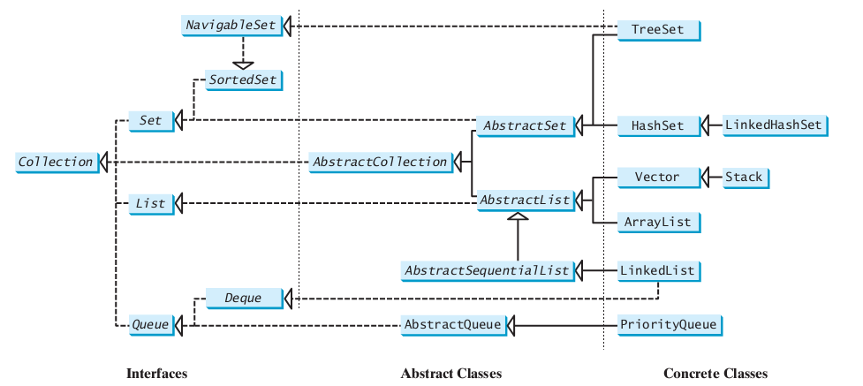
Collections

Slide 5
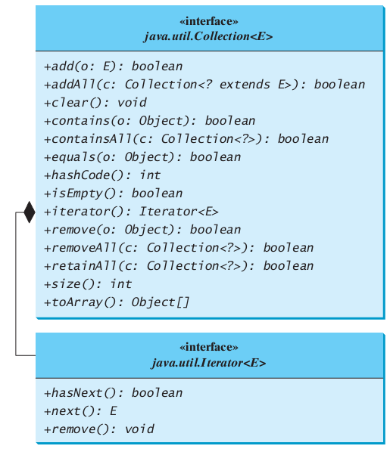
Collection

Slide 6
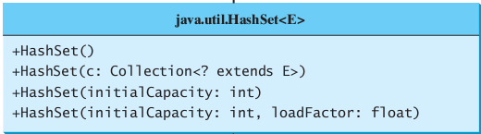
Set
An instance of Set stores a group of non-duplicate elements.
HashSet
For efficiency, objects added to a hash set need to implement the hashCode method in a manner that properly disperses the hash code
Demo
TestHashSet

Slide 7
Set
LinkedHashSet
LinkedHashSet extends HashSetwith a linked-list implementation that supports an ordering of the elements in the set.
Demo
TestLinkedHashSet.java

Slide 8
Set
SortedSet
SortedSet is a subinterface of Set , which guarantees that the elements in the set are sorted.
TreeSet
TreeSetimplements the SortedSet interface.
You can add objects into a tree set as long as they can be compared with each other.
Demo
TestTreeSetWithComparator.java

Slide 9
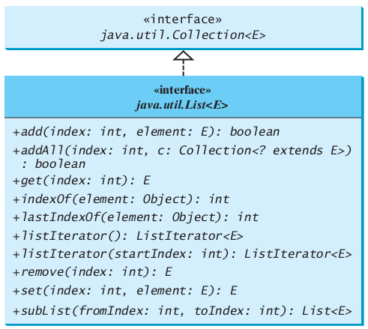
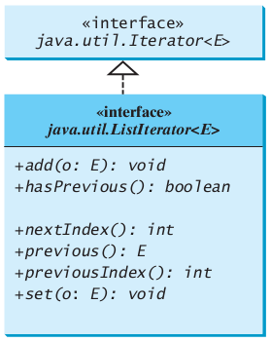
Lists
To allow duplicate elements to be stored in a collection, you need to use a list

Slide 10
List
ArrayList
ArrayList stores elements in an array. The array is dynamically created and increased if necessary.
LinkedList
LinkedList stores elements in a linked list.
How to choose:
If your application does not require the insertion or deletion of elements, an array is the most efficient data structure.
Demo
TestArrayAndLinkedList.java

Slide 11
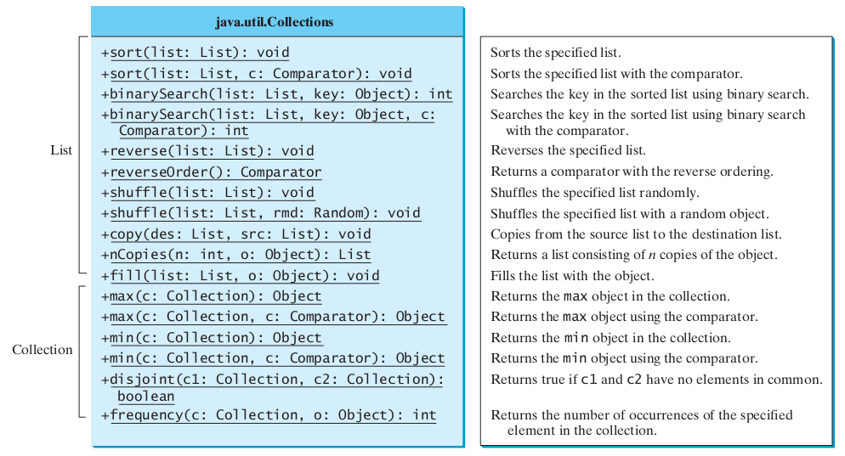
Static Methods for Lists and Collections

Slide 12
Performance of Sets and Lists
Demo
SetListPerformanceTest.java

Slide 13
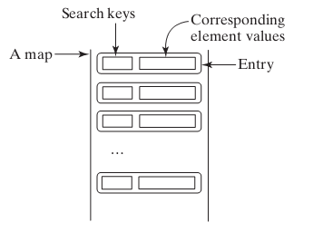
Maps
A map is a container that stores the elements along with the keys.
In List, the indexes are integers, In Map , the keys can be any objects.

Slide 14
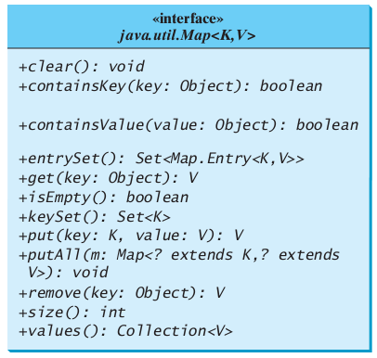
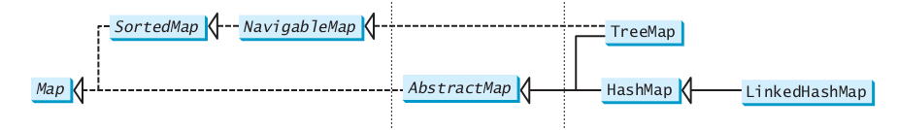
Map
Map interface

Slide 15
Map
Demo
TestMap

Slide 16

Google's Guava library
guava: Google's add-on library for Java.
used and developed internally for years by Google developers
now released as free open source software
adds many useful classes and features to Java libraries
avoiding null, exception handling, new collections, functional programming, simple I/O, event processing, math functions, reflection, ...
download from http://code.google.com/p/guava-libraries/
API docs at http://docs.guava-libraries.googlecode.com/git-history/release/javadoc/index.html

Slide 17
Multiset
multi-set: a set of counters; also called a "bag"
counts the # of times each unique value was added
meant to replace Map<K, Integer>
implementations: HashMultiset,LinkedHashMultiset,TreeMultiset
// convention: construct using create() method
Multiset<String> mset = HashMultiset.create();
"the"=7
"if"=2
"of"=1
mset.count("to")
"to"=3
"down"=1
"from"=4
3
set.count("boo")
set.contains("boo")
"by"=2
"she"=2
0
false
"in"=5
"you"=4
"him"=2
multiset

Slide 18
Multiset methods
class.create() class.create(collection) | creates a new empty multiset, or one based on the elements of a collection
add(value) add(value, count) | adds 1 occurrence of value to collection; or adds the given # of occurrences
contains(value) | true if set contains ≥ 1 occurrence of value
count(value) | returns # of occurrences of value; 0 if not found
iterator() | an object to examine all values in the set
remove(value) remove(value, count) | removes 1 occurrence of the given value; or removes the given # of occurrences
setCount(value, count) | causes the given value to have the given count
size() | returns sum of all counts
toString() | string such as "[a x 4, b x 2, c]"
elementSet(), entrySet() | collection views of the multiset

Slide 19
Multimap
multi-map: a map from keys to collections of values
meant to replace Map<K, Set<V>> or Map<K, List<V>>
implementations: ArrayListMultimap, LinkedListMultimap, HashMultimap, LinkedHashMultimap, TreeMultimap
// political party -> people in it Multimap<String, String> mmap = TreeMultimap.create(); mmap.put("D", "Gore"); mmap.put("D", "Clinton");
"R"
[Obama, Kerry, Gore, Clinton]
"D"
[Paul, Johnson]
"I"
[Romney, McCain, Bush]
keys
values

Slide 20
Multimap methods
class.create() class.create(map) | creates a new empty multimap, or one based on the elements of a map
clear() | removes all key/value pairs
containsKey(key) | returns true if the given key is stored
get(key) | returns collection of values associated with key
put(key, value) | adds value to this key's collection
putAll(key, collection) | adds all given values to this key's collection
remove(key, value) | removes value from this key's collection
removeAll(key) | removes all values associated with this key
size() | returns number of key/value pairs
toString() | string such as "{a=[b, c], d=[e]}"
asMap(), keys(), keySet(), values() | various collection views of the map's data

Slide 21
Choosing a Multimap
The Multimap has two sub-ADT interfaces:
ListMultimap → ArrayListMultimap, LinkedListMultimap
SetMultimap → Hash, LinkedHash, TreeMultimap
If you need list-specific methods, declare it as a ListMultimap.
ListMultimap<String, String> mmap =
ArrayListMultimap.create(); mmap.put("D", "Gore"); mmap.put("D", "Clinton");
System.out.println(mmap.get("D").get(0); // Gore
System.out.println(mmap.get("D").get(1); // Clinton

Slide 22
BiMap
bi-map: a two-directional map
for data where a → b and also b → a in symmetry
avoids need to try to "invert" a map or store an inverse map
implementations: HashBiMap

Slide 23
BiMap
// state <--> state capital BiMap<String, String> bmap = HashBiMap.create(); mmap.put("Arizona", "Phoenix"); mmap.put("Washington", "Olympia");
"Washington"
"Sacramento"
"California"
"Phoenix"
"Arizona"
"Olympia"
keys
values

Slide 24
BiMap methods
all methods from Map are present as well
clear, containsKey, containsValue, equals, get, isEmpty, keySet, put, putAll, remove, size, toString
class.create() class.create(map) | creates a new empty bi-map, or one based on the elements of a map
inverse() | returns BiMap<V, K> in opposite direction
values() | returns set of all values

Slide 25
Table
table: a two-dimensional (key+key) / value structure
meant to replace Map<R, Map<C, V>>
a map stores pairs of form (K, V) where only K is known later; a table stores triples of form (R, C, V) where R,C are known later
implementations: HashBasedTable, TreeBasedTable, ArrayTable
// (name + SSN => age) Table<String, String, Integer> table = TreeBasedTable.create(); table.put("Marty Stepp", "597-24-6138", 29);
name | SSN | age
Marty Stepp | 597-24-6138 | 29
Stuart Reges | 703-34-1593 | 84

Slide 26
Table methods
class.create() | creates a new empty table, etc.
cellSet() | set of all (R, C, V) triples
clear() | remove all values
column(C) | returns column for given key as Map<R,V>
contains(R, C) | true if table has a mapping for the given keys
containsRow(R), containsColumn(C) | true if table has any mapping that includes the given row or column key
get(R, C) | returns value for the given keys, or null
isEmpty() | true if there are no values
put(R, C, V) | stores (R, C, V) triple in the table
putAll(table) | adds all of the given table's data to this one
remove(R, C) | removes any value mapped from the given keys
row(R) | returns row for given key as a Map<C,V>
size() | number of triples in table
toString() | string such as "{a={b=c, d=e},f={g=h}}"

Slide 27
RangeSet
range set: a group of comparable ranges of values
like a set, but you can add an entire range at a time
implementations: TreeRangeSet
// teenagers and old people RangeSet<Integer> ages = TreeRangeSet.create(); ages.add(Ranges.closed(13, 19)); ages.add(Ranges.atLeast(65)); System.out.println(rset.contains(15)); // true System.out.println(rset.contains(72)); // true
< 0 | 0 ... 12 | 13 ... 19 | 20 ... 64 | ≥ 65 ...

Slide 28
RangeSet methods
class.create() | creates a new empty range set, etc.
add(range) | adds the given range of values
addAll(rangeset) | adds all ranges from the given set
clear() | removes all ranges
encloses(range) | true if set contains the entire given range
enclosesAll(rangeset) | true if set contains all ranges in given set
isEmpty() | true if there are no ranges
remove(range) | removes the given range of values
span() | a Range representing all values in this set
subRangeSet(range) | subset containing relevant ranges
toString() | string such as "[1..3], (6..65]"

Slide 29
Specifying ranges
Specify a range of values by calling static methods of the Range class, each of which returns a Range object.
Ranges.closed(min, max) | [min .. max] including both endpoints
Ranges.open(min, max) | (min .. max) excluding min and max
Ranges.closedOpen(min, max) | [min .. max) include min, exclude max
Ranges.openClosed(min, max) | (min .. max] exclude min, include max
Ranges.atLeast(min) | [min .. ∞) including min
Ranges.greaterThan(min) | (min .. ∞) excluding min
Ranges.atMost(max) | (-∞ .. max] including max
Ranges.lessThan(max) | (-∞ .. max) excluding max
Ranges.all() | all possible values, (-∞ .. ∞)
Ranges.singleton(value) | [value]; just a single value

Slide 30
RangeMap
range map: like a range set, but stores (range, value) pairs
implementations: TreeRangeMap
// body mass index -> description RangeMap<Double, String> bmi = TreeRangeMap.create(); bmi.put(Range.lessThan(18.5), "underweight"); bmi.put(Range.closedOpen(18.5, 25.0), "normal"); bmi.put(Range.closedOpen(25.0, 30.0), "overweight"); bmi.put(Range.atLeast(30.0), "obese"); System.out.println(bmi.get(27.1)); // "overweight"
< 18.5 | 18.5 .. 25.0 | 25.0 .. 30.0 | ≥ 30.0
underweight | normal | overweight | obese

Slide 31
RangeMap methods
class.create() | creates a new empty range map, etc.
put(range, value) | adds range/value pair
putAll(rangemap) | adds all range/value pairs from given map
clear() | removes all ranges
get(key) | returns value for range containing key
isEmpty() | true if there are no ranges
remove(range) | removes all values in the given range
span() | a Range representing all keys in this set
subRangeMap(range) | submap containing relevant ranges
toString() | string such as "{[1..3]=a, (6..65]=b}"

Slide 32
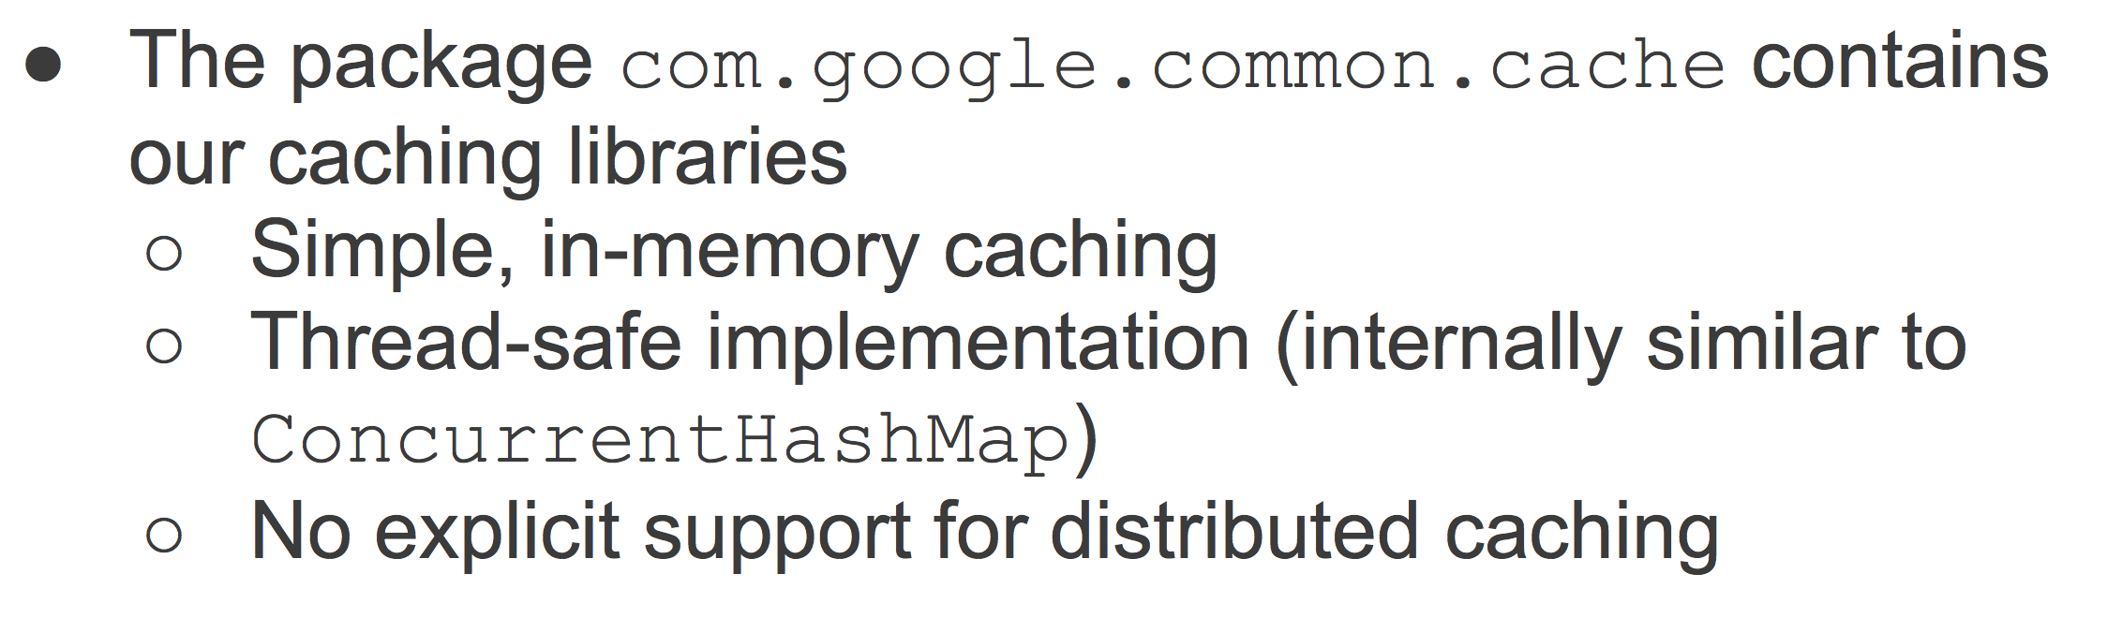
Cache

Slide 33
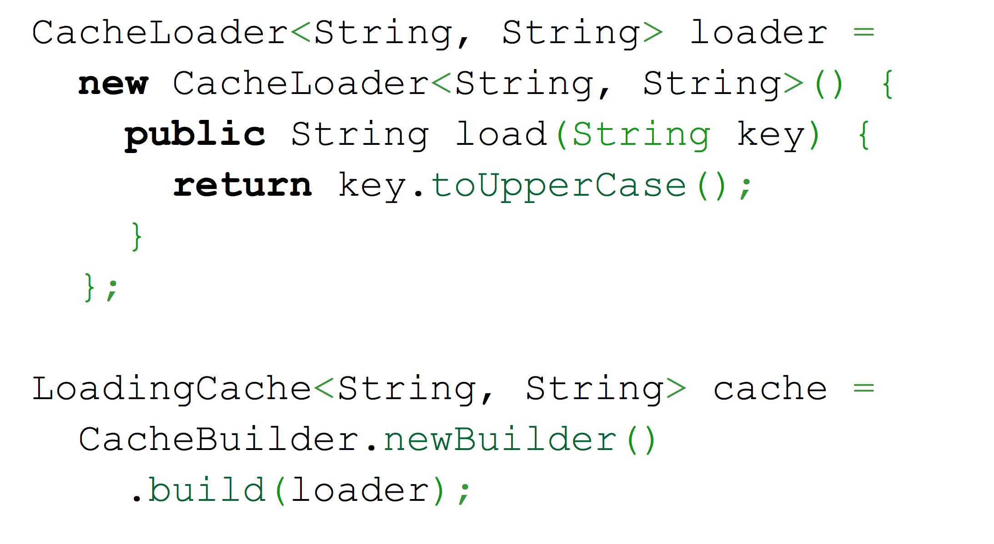
Simple Cache

Slide 34
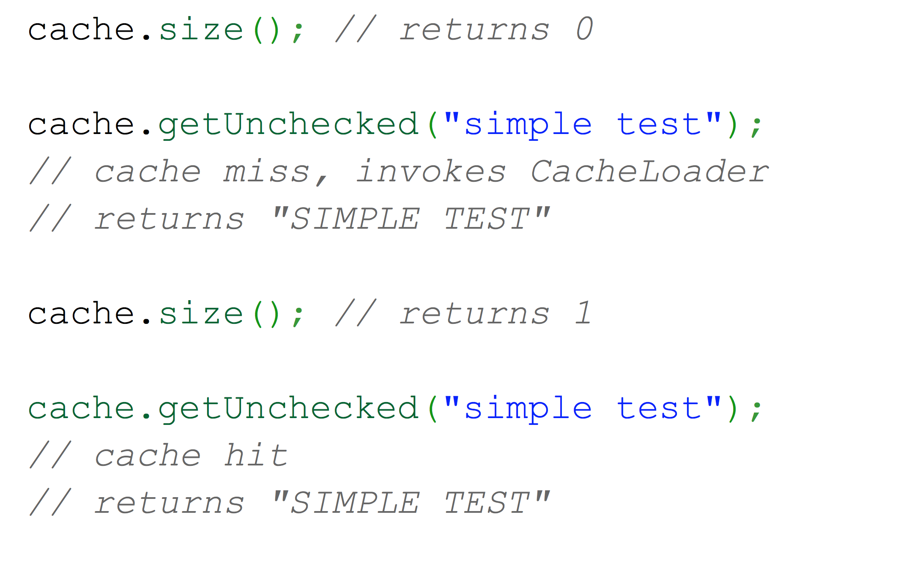
Simple Cache

Slide 35
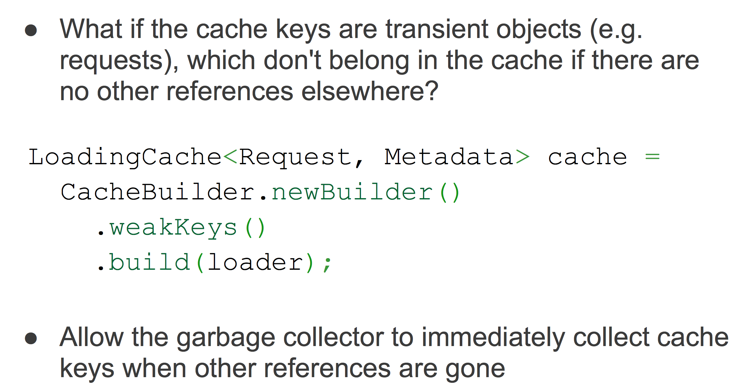
Weak Keys

Slide 36
Other cool features
Collections2: utility methods related to all collections
Lists: utility methods related to lists
Sets: utility methods related to sets
Queues: utility methods related to queues
Multisets, Multimaps: utility methods related to multiset/map
Tables: utility methods related to tables
Iterables: utility methods related to collections and for-each
Iterators: utility methods related to iterators and iteration
Ordering: easy-to-create comparable and comparator orders
Immutable*: collections that cannot be modified
see also: http://code.google.com/p/guava-libraries/wiki/CollectionUtilitiesExplained

